Slide 1


Slide 2
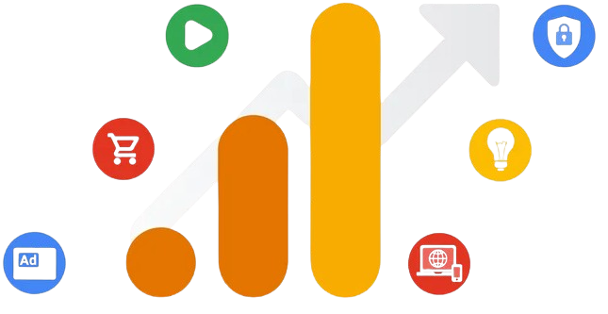
Introduction to Google Analytics

Slide 3
Google Analytics is a web analytics service that tracks and reports website traffic
What is Google Analytics?
Definition
Purpose
Helps businesses understand user behavior
Measures performance
Optimizes marketing efforts

Slide 4
Importance of Google Analytics
Data-Driven Decisions
Empowers businesses to make informed decisions based on user data
User Insights
Provides valuable insights into user demographics, interests, and behavior
Tracking Goals
Helps set and track goals (e.g., conversions, sign-ups) to measure success
Performance Monitoring
Monitors website performance, traffic sources, and user engagement

Slide 5
Key Features of Google Analytics
Real-Time Data
Monitor activity on your site as it happens
Audience Reports
Analyze user demographics, interests, and behaviors
Acquisition Reports
Understand how users arrive at your site (organic, paid, referral)
Behavior Reports
Explore user interactions with content (page views, bounce rates)
Conversion Tracking
Measure goal completions and e-commerce transactions

Slide 6
Setting Up Google Analytics
Step 1
Create a Google Analytics Account
Visit the Google Analytics website and sign up
Step 2
Set Up a Property
Add your website as a property in your account
Step 3
Install Tracking Code
Copy and paste the tracking code into your website’s HTML
Step 4
Verify Tracking
Use the real-time reports to ensure tracking is working correctly

Slide 7
Navigating the Google Analytics Dashboard
Overview of the Interface
Explain the main sections: Home, Reporting, Customization, and Admin
Key Reports to Explore
Audience, Acquisition, Behavior, and Conversions
Using the Search Bar
Quickly find specific reports and metrics

Slide 8
Understanding Key Metrics
Sessions
Total number of visits to your site
Users
Unique visitors to your site during a specific period
Pageviews
Total number of pages viewed by users
Bounce Rate
Percentage of users who leave the site after viewing only one page
Average Session Duration
Average time users spend on your site

Slide 9
Best Practices for Using Google Analytics
Regularly Monitor Data
Check reports frequently to stay informed about user behavior
Set Up Custom Dashboards
Create dashboards tailored to your specific metrics and goals
Use Segments
Analyze subsets of users (e.g., new vs. returning) for deeper insights
Integrate with Other Tools
Connect Google Analytics with Google Ads, Search Console, and other marketing tools

Slide 10
Discussion Questions
Have you used Google Analytics before? What features did you find most useful?
(Encourage participants to share their experiences and insights)
What specific metrics do you think are most important for your marketing strategy?
(Facilitate discussion on metrics that resonate with their marketing goals)

Slide 11


Slide 12


